Slide 1
Airplane Crashes Analysis with tableau
Abobakr Emary
Mentorness | Batch : MIP-DA-06

Slide 2
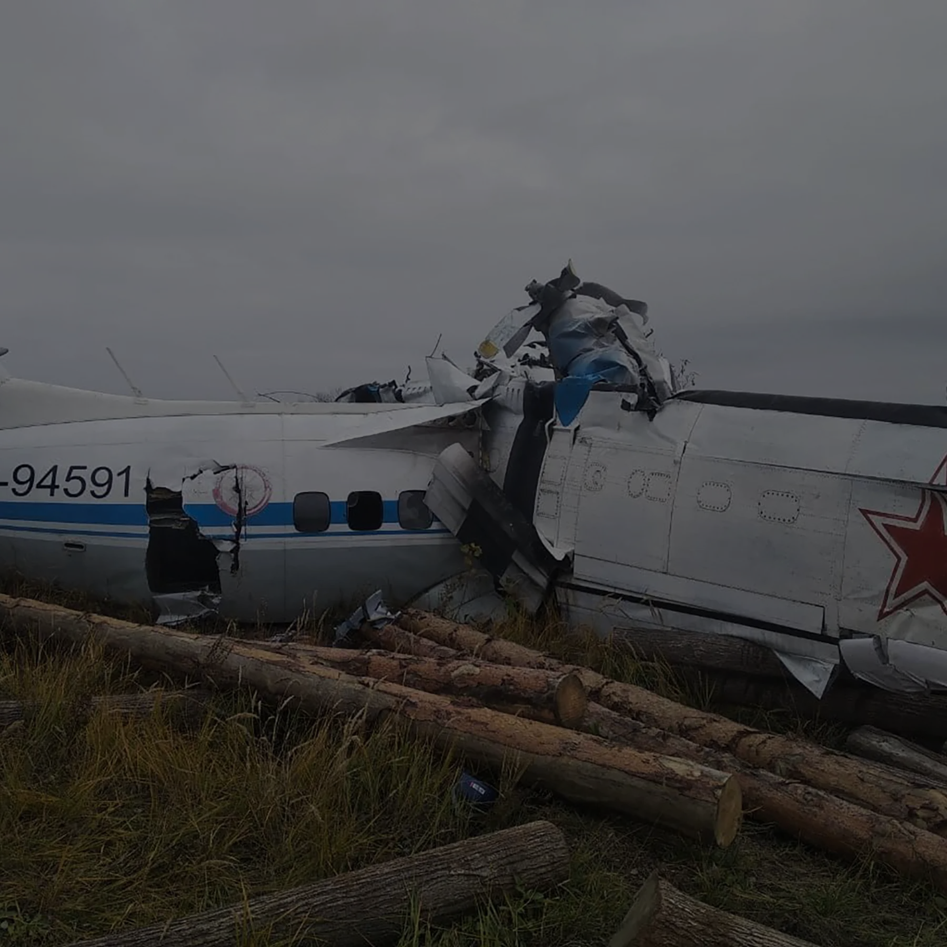

AGENDA
Problem Statement
PROJECT Objective
Data Cleaning
Dashboards
SUMMARY

Slide 3

PROBLEM STATEMENT
This internship project focuses on conducting a comprehensive analysis of airplane crashes and fatalities spanning from 1980 to 2023. The dataset contains crucial information such as crash dates, locations, operators, flight details, aircraft types, and fatality statistics. The goal is to leverage tableau for interactive visualizations and in-depth insights to understand patterns, contributing factors, and trends in aviation incidents. The analysis aims to provide stakeholders with valuable information for enhancing aviation safety and mitigating risks.

Slide 4
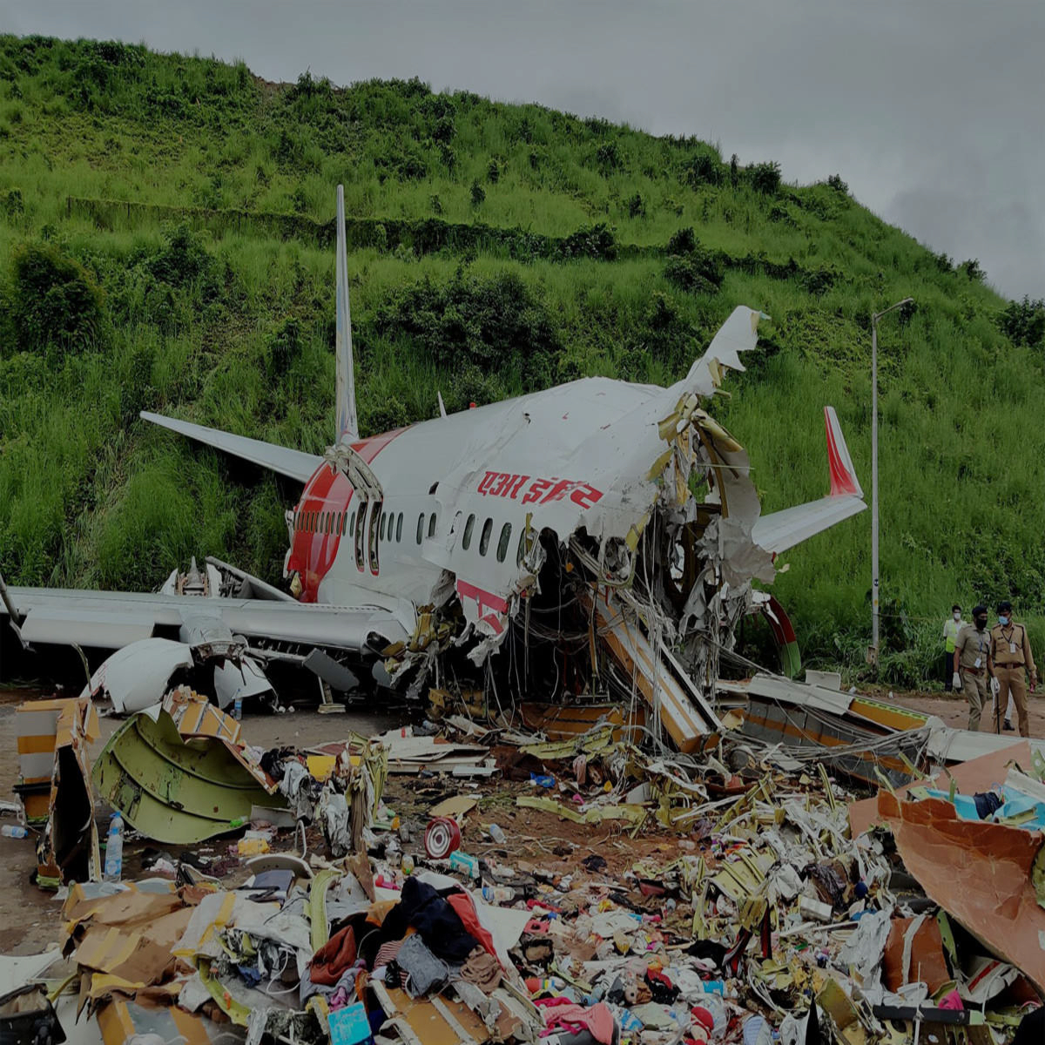
PROJECT OBJECTIVE
Temporal Analysis:
Explore temporal trends in airplane crashes over the years.
Identify patterns in the frequency and severity of incidents.
Geospatial Analysis:
Visualize crash locations on a map to identify hotspots.
Analyze the distribution of incidents across different regions.

Slide 5
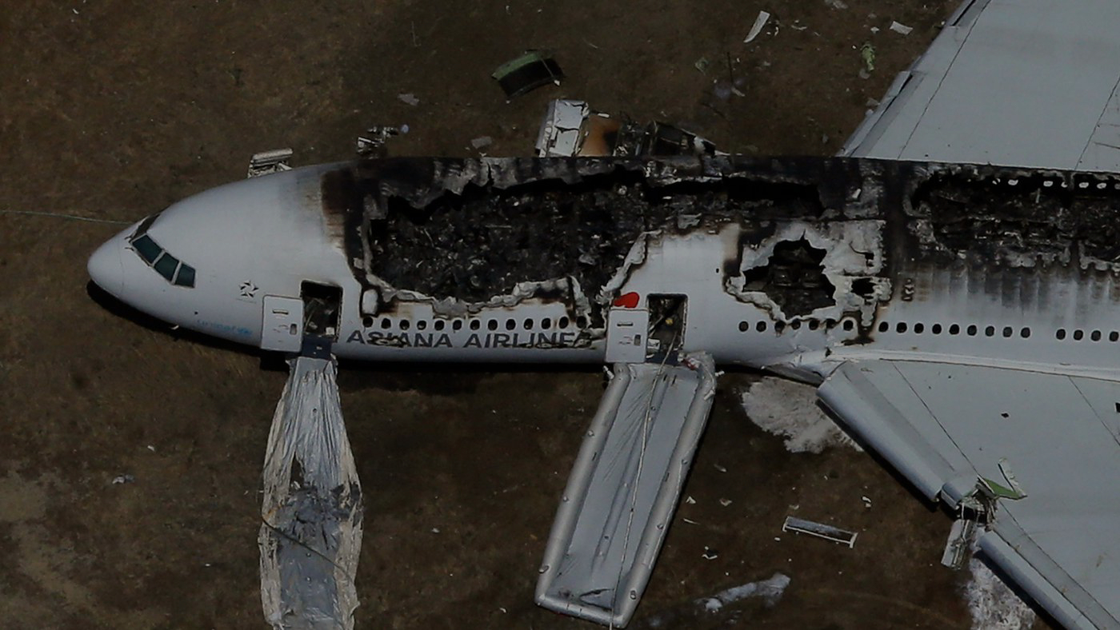
PROJECT OBJECTIVE
Operator Performance:
Evaluate the safety records of different operators and airlines.
Identify operators with higher incident rates.
Aircraft Analysis:
Analyze the involvement of specific aircraft types in incidents.
Examine the relationship between aircraft registration and crash occurrences.

Slide 6

PROJECT OBJECTIVE
Fatality Trends:
Explore trends in passenger and crew fatalities.
Investigate factors contributing to fatalities.
Route Analysis:
Analyze incident patterns on specific flight routes.
Identify routes with a higher likelihood of incidents.

Slide 7
Data Cleaning Process
The data cleaning process involved removing missing values, standardizing formats, and ensuring data accuracy and consistency. Additionally, a new column called country, provide contextual information and enhance the dataset's analytical depth. Country where each incident occurred. The data cleaning and enrichment efforts ensure that the dataset is well-prepared for accurate analysis and informed decision-making in aviation safety

Slide 8
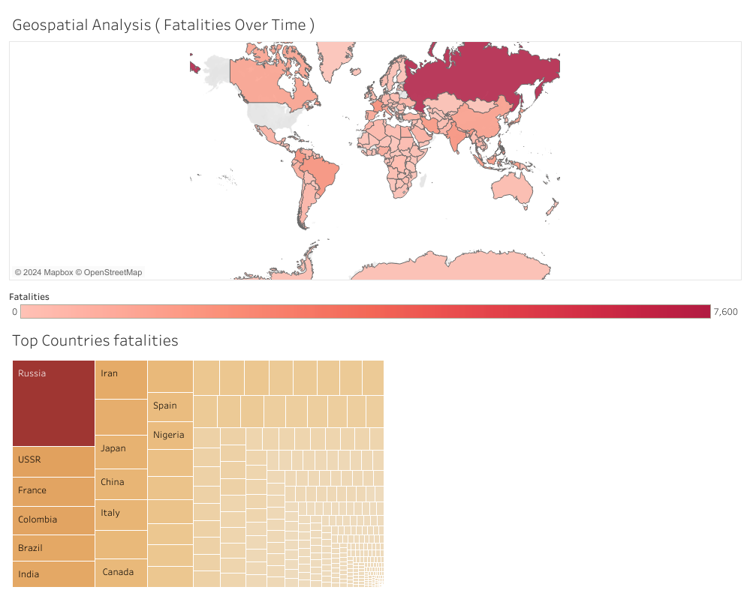
Geospatial Analysis

Slide 9
GEOSPATIAL ANALYSIS
BY VISUALIZING CRASH LOCATIONS ON A WORLD MAP, HOTSPOTS OF INCIDENTS WERE IDENTIFIED, ENABLING STAKEHOLDERS TO FOCUS THEIR ATTENTION ON REGIONS WITH HIGHER INCIDENT RATES. ADDITIONALLY, THE DISTRIBUTION OF INCIDENTS ACROSS DIFFERENT REGIONS, WAS ANALYZED TO PRIORITIZE SAFETY MEASURES AND ALLOCATE RESOURCES EFFECTIVELY.

Slide 10
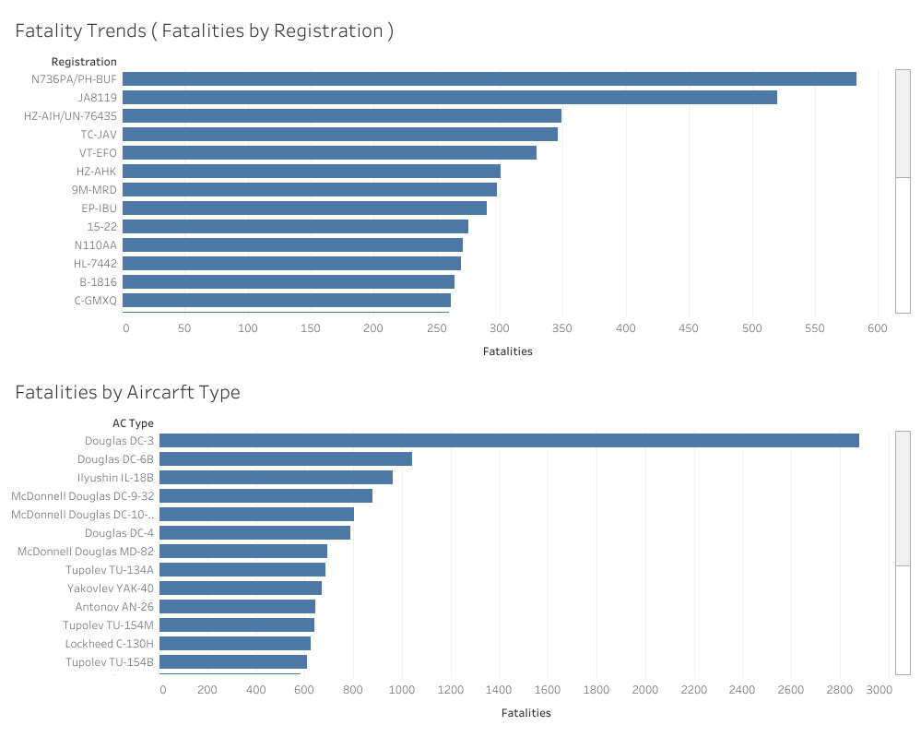
Fatality Trends

Slide 11
FATALITY TRENDS
EXPLORING THE TRENDS IN PASSENGER AND CREW FATALITIES REVEALED FLUCTUATIONS OVER THE YEARS, REFLECTING THE DYNAMIC NATURE OF AVIATION SAFETY. THROUGH INTERACTIVE VISUALIZATIONS, STAKEHOLDERS GAINED A DEEPER UNDERSTANDING OF HOW FATALITIES HAVE EVOLVED OVER TIME. THIS ANALYSIS PROVIDED VALUABLE INSIGHTS INTO THE EFFECTIVENESS OF SAFETY MEASURES AND THE IMPACT OF REGULATORY CHANGES ON REDUCING FATALITIES IN AIRPLANE INCIDENTS.

Slide 12
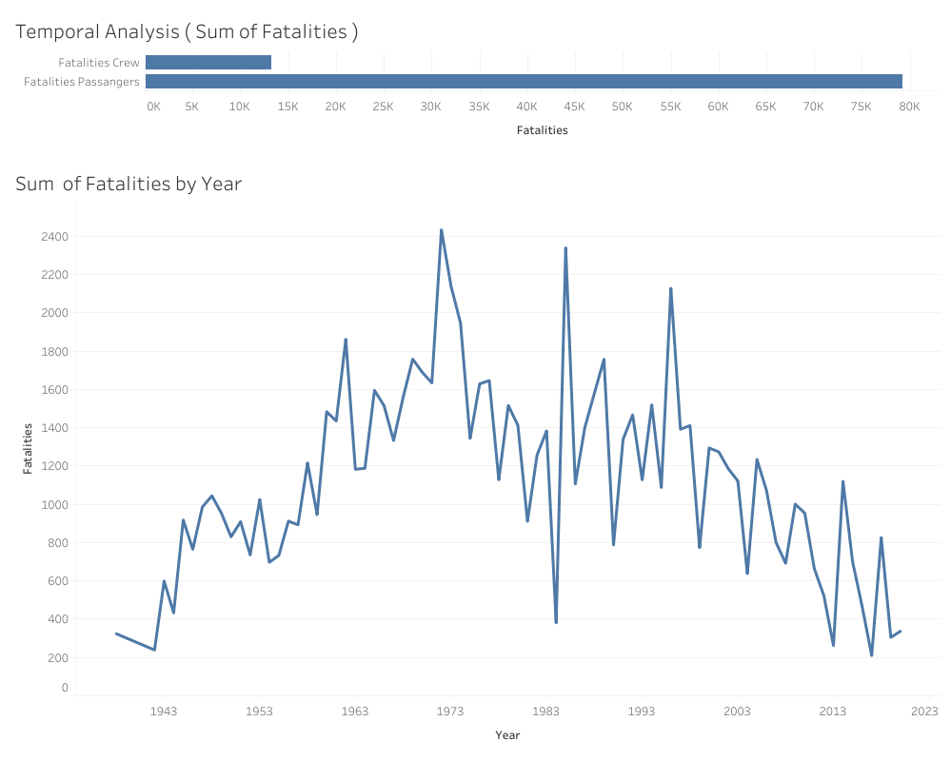
Temporal Analysis

Slide 13
TEMPORAL ANALYSIS
Temporal analysis revealed fluctuations in the frequency of airplane crashes over the years, with notable spikes and declines observed. Further investigation into these trends identified potential factors contributing to variations in crash frequency, offering insights for proactive safety measures. Additionally, the sum of fatalities , was analyzed to understand the distribution of fatalities across different incident types over time.

Slide 14
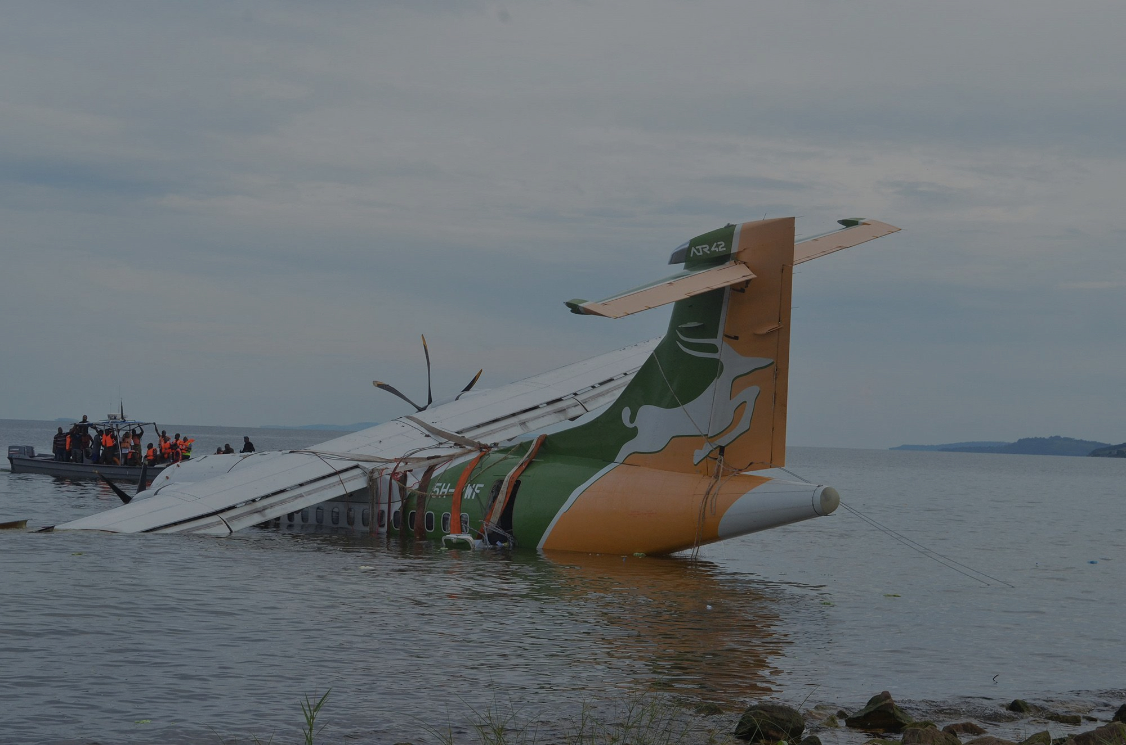
SUMMARY
Our analysis of airplane crashes and fatalities from 1980 to 2023, using tools like Tableau, has revealed key insights. We've identified trends, assessed incident severity, and pinpointed factors impacting fatalities, setting the stage for improved aviation safety. Our data cleaning has ensured accuracy, and adding categorical columns like Country has enriched our dataset. we'll use this information to enhance aviation safety measures and ensure a safer air travel environment.

Slide 15
THANK YOU
Abobakr Emary
abobakr.emary@gmail.com
Mentorness

